Slide 1


A Piece of Cake C# Powered Cross-platform Build Automation
Gary Ewan Park

Slide 2
Who Am I?
Gary Ewan Park
Senior Software Engineer at Chocolatey
Microsoft Developer Technologies MVP
Open Source Contributor
Cake Maintainer
Husband of 1, father of 2
Pretty much gep13 everywhere online

Slide 3
What is a Build?
Package Restore
Clean
StyleCop
Compile
Roslyn Analyzers
Analyze
DupFinder
InspectCode
Unit Test
Test Coverage
Package
Publish

Slide 4
What is Cake?
Build Orchestration Tool
Open Source
Cross Platform
Cross Environment
Cross Service
Cross Runtime
C# DSL
Notes:
Re-usable
Maintainable
Orchestration – Doesn’t replace MSBuild
Open Source – Issues, PR’s, Gitter, Discussions
Platform - Windows/Mac/Linux
Environment - Run locally and on prem, containers, etc
Service – AppVeyor, Azure DevOp, Circle CI
Runtime - .Net, Mono, Core

Slide 5
Where can I install Cake from?
NuGet
Cake, Cake.Tool
Cake.CoreCLR
Cake.Frosting
Chocolatey
Cake.Portable
Home Brew
Cake
Docker Hub
cakebuild/cake
Notes:
Different versions of Cake – due to history for project

Slide 6
Getting started
// Run from root of your repository
// Only required to be run once
dotnet new tool-manifest
dotnet tool install Cake.Tool
// What you would run on a CI Server
dotnet tool restore
dotnet cake
Notes:
Ensures consistency – pinning to specific version of Cake.Tool

Slide 7
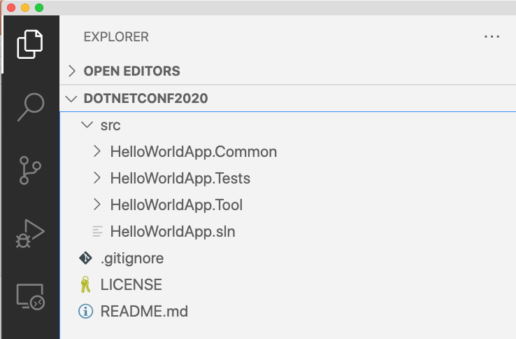
Lets build something with Cake…

Slide 8
Example Build
Package Restore
Clean
Compile
Unit Test
Package

Slide 9
Demo
Lets build with Cake…

Slide 10
What’s next? Let’s extend Cake…
Addins
#addin nuget:?package=Cake.Twitter&version=0.10.1
Script
#load scripts/utilities.cake
#load nuget:?package=Cake.Recipe&version=2.0.1
Modules
#module nuget:?package?Cake.Npm.Module&version=0.1.0
Notes:
Lots of tools included, but there are lots of community driven addins
- Slack
- Git
- etc
Re-usable scripts
Modules – allows replacing anything within the internal of Cake – Dependency Injection, IoC, etc

Slide 11

Thanks for joining!
More information at https://cakebuild.net/

